Slide 1
Two-way ANOVA——Amputee data (three)

Slide 2
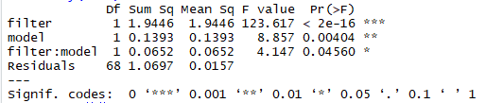
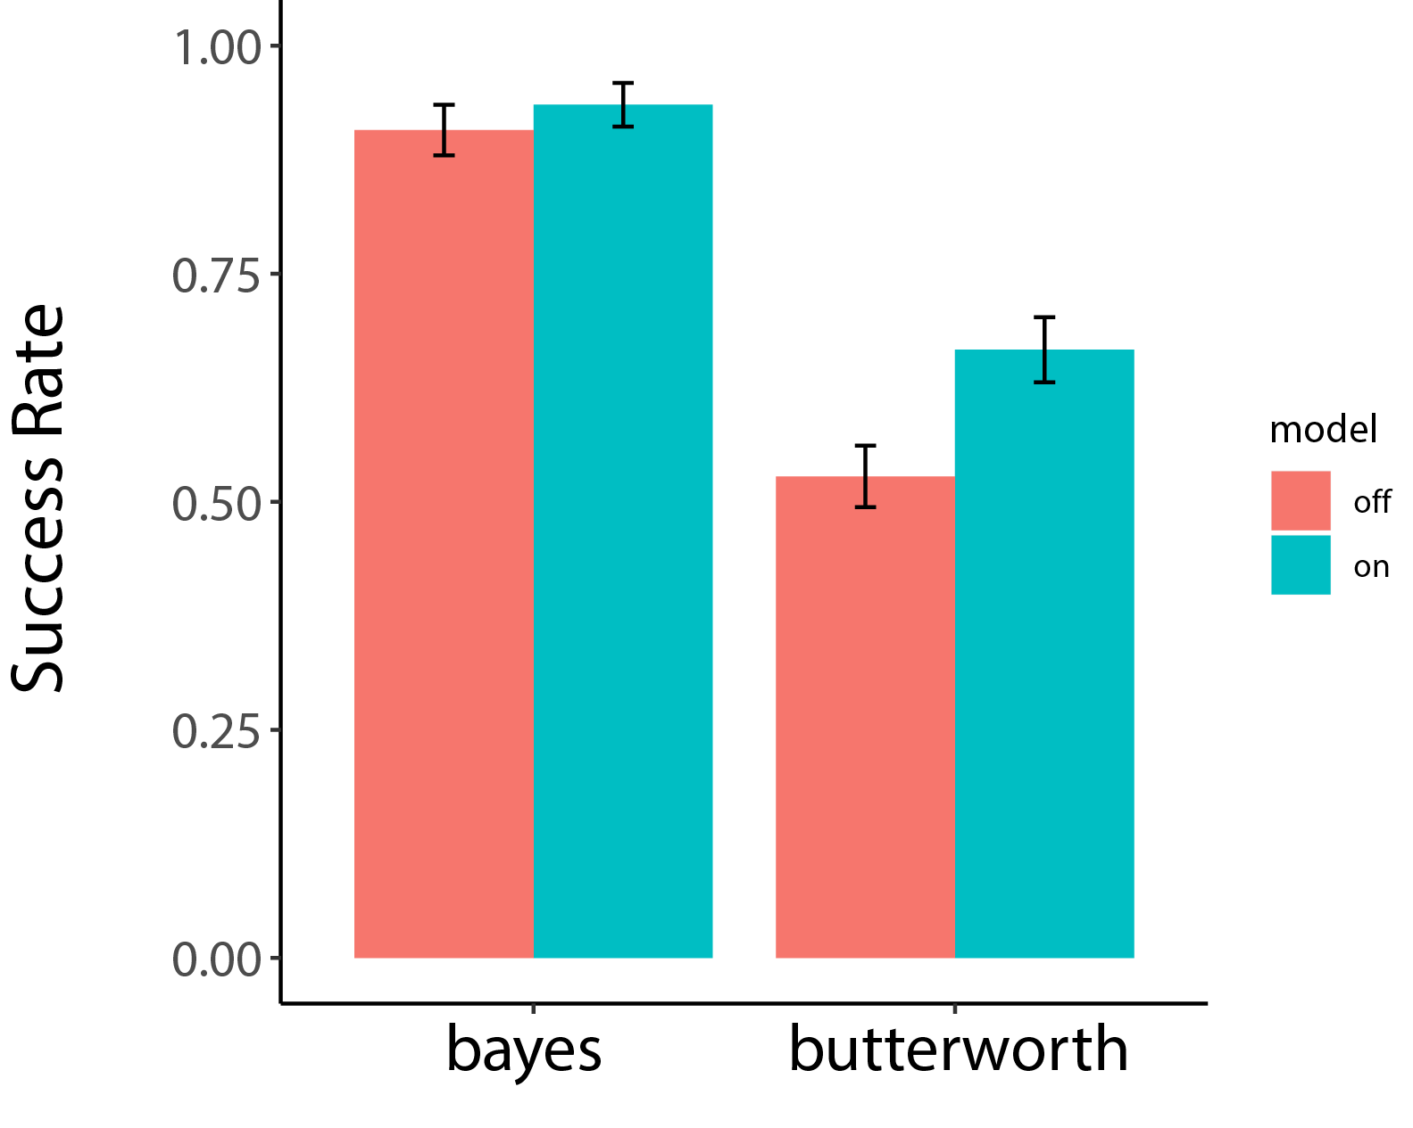
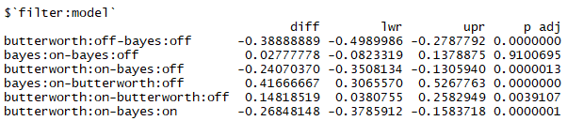
Success rate——Amputee
filter—F(1,68)=123.617, P<0.001
model—F(1,68)=8.857, P<0.01
filter: model —F(1,68)=4.147, P<0.05

Slide 3
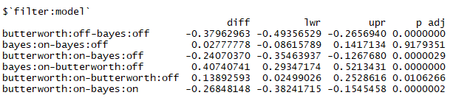
SR — post hoc test

Slide 4
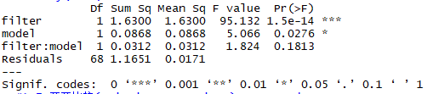
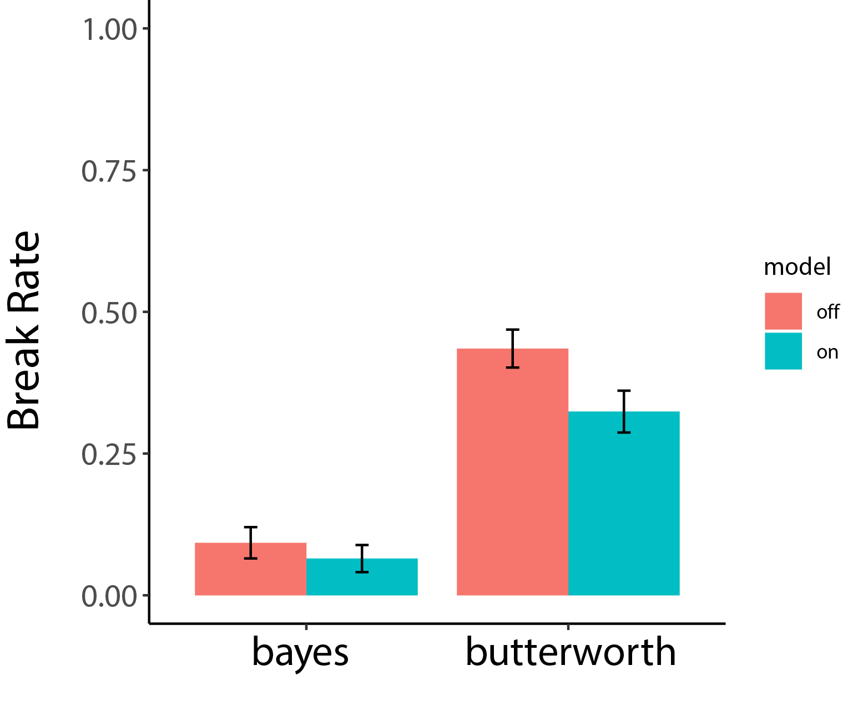
Beak rate ——Amputee
filter—F(1,68)=95.132, P<0.001
model—F(1,68)=5.066, P<0.05
filter: model —F(1,68)=1.824, P=0.1813

Slide 5
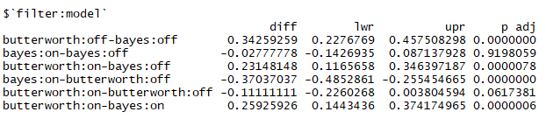
BR — post hoc test

Slide 6
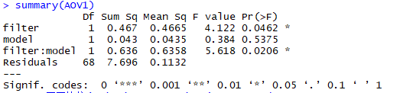
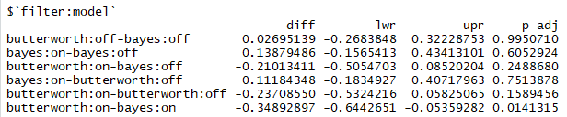
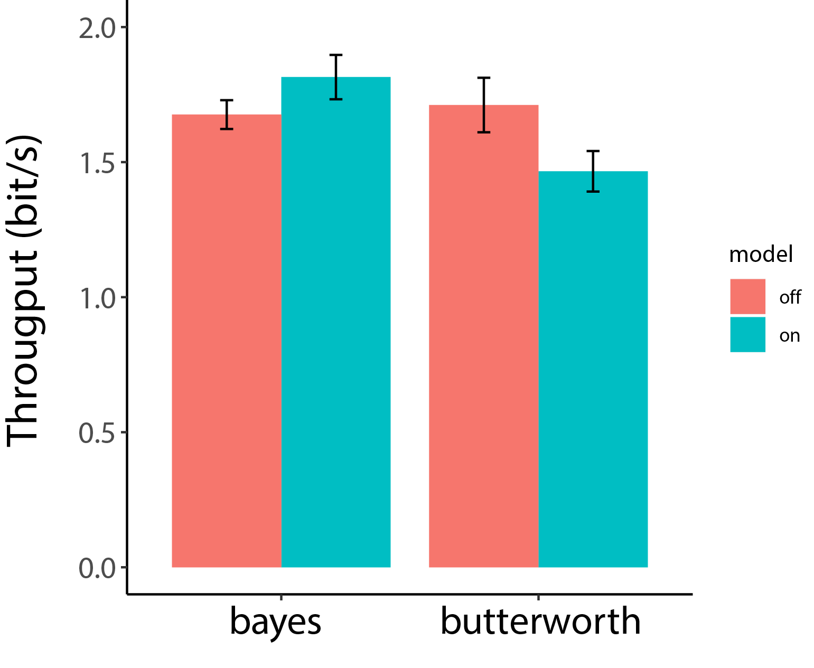
Throughput ——Amputee
filter—F(1,68)=4.122, P=0.0462
mode—F(1,68)=0.384, P=0.5375
filter: model —F(1,68)=5.618, P<0.05

Slide 7
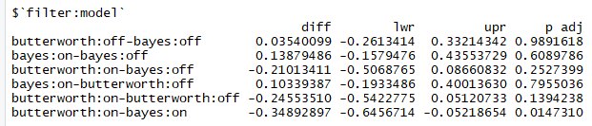
TP — post hoc test

